Slide 1
AICircle Web Development Project
Business connection platform

Slide 2
AIM
01
Market response
02
Web Function
Framework
TABLE OF CONTENTS
04
03
Q & A
05
Aim of business
User group
Detail on web function
Technical structure of project
Here you could describe the topic of the section

Slide 3
01
AIM
Aim of business

Slide 4
Business connection
Our aim of the project is to build a business connection platform, for businessman to find partner easliy and more efficient.

Slide 5
02
Market response
User group

Slide 6
Market Response
The project have a group of investor already. Therefore, we would consider them as our starting user group. Thus, our group of target audience can be easily built.

Slide 7
03
Framework
Technical structure of project

Slide 8
Framework
Frontend
Backend
Datebase
API
React.js
Node.js
Mongodb
Express.js

Slide 9
My responsibility
Frontend design
Backend design
-Coding on HTML, CSS, JS etc
-UI design
-Connect Node.js and MongoDB
-Data app remote/delete (postman)

Slide 10
04
Web Function
Detail on web function

Slide 11
Web Function
Login
Profile
Branch
Ranking
Connection
Chatbox
&
Searching
Landing Page
Register

Slide 12
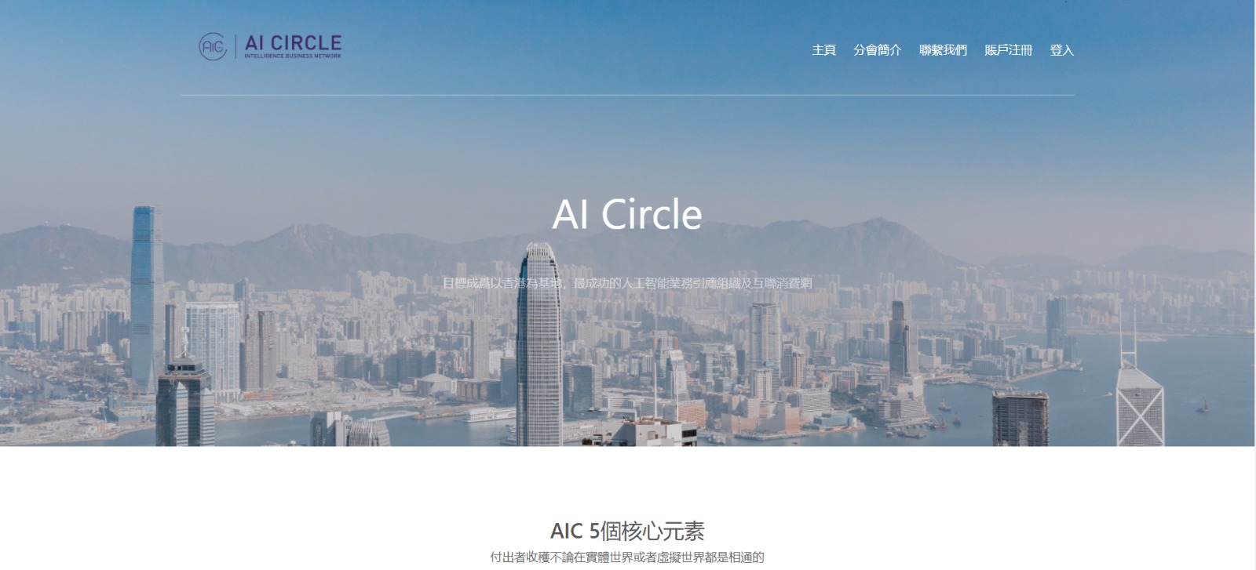
Landing Page

Slide 13
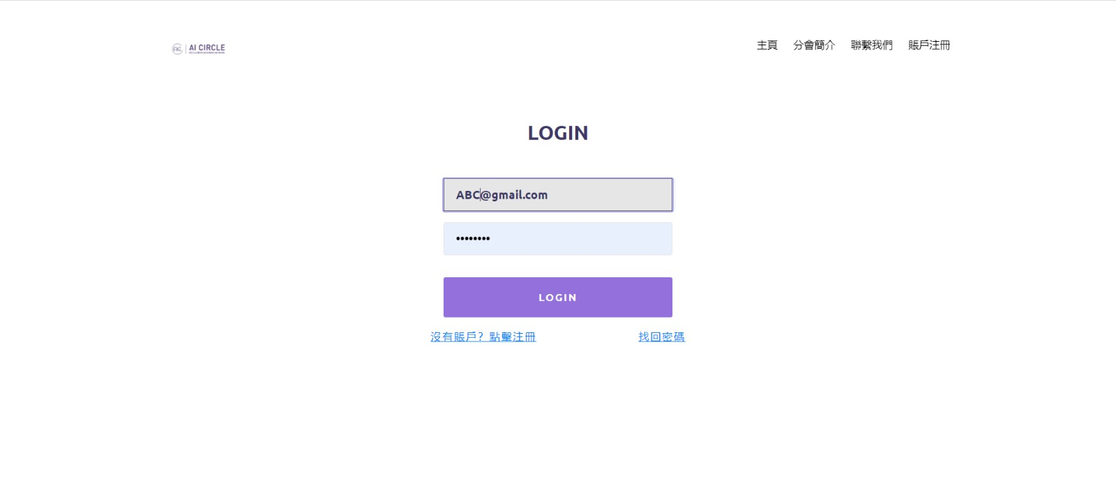
Login

Slide 14
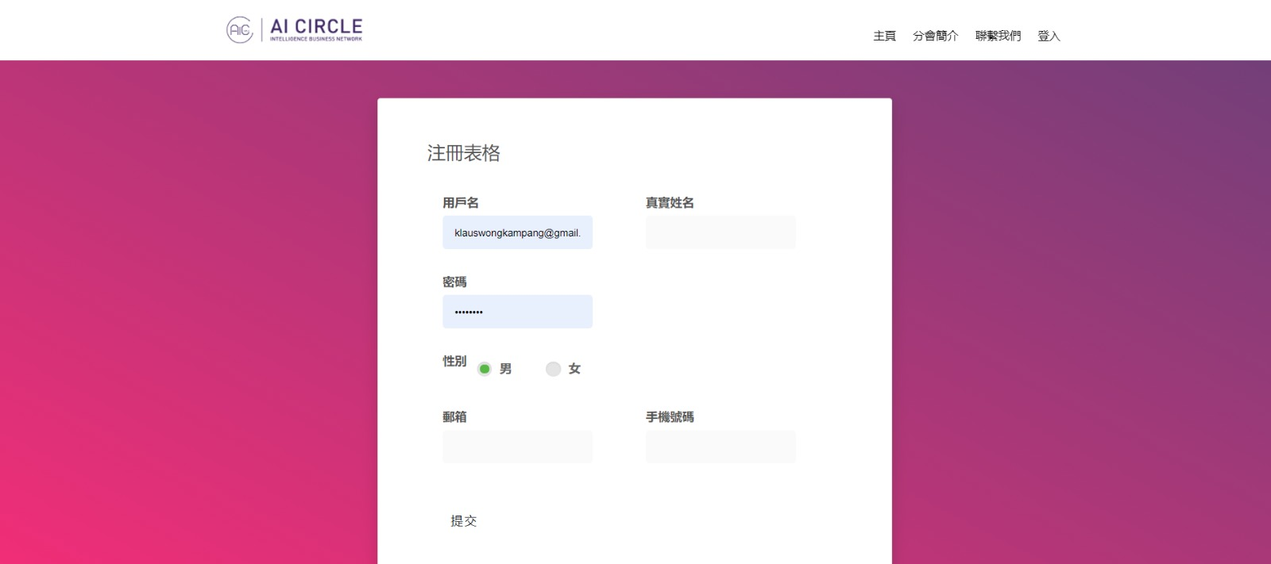
Register

Slide 15
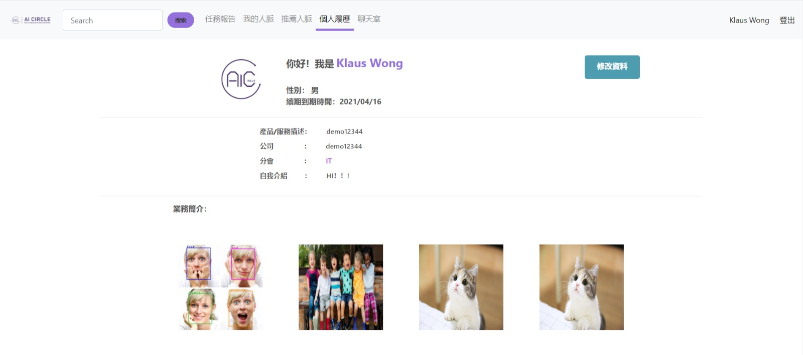
Profile

Slide 16
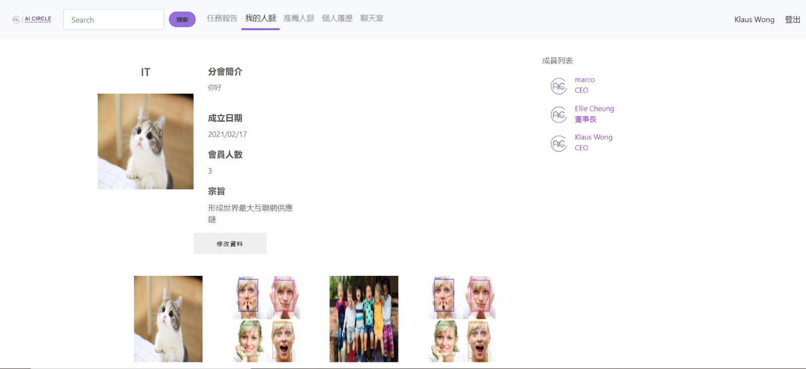
Branch

Slide 17
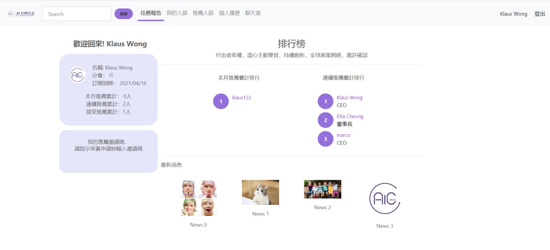
Ranking

Slide 18
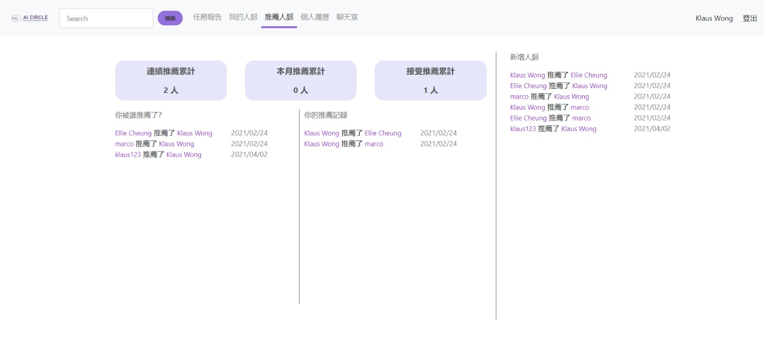
Connection

Slide 19
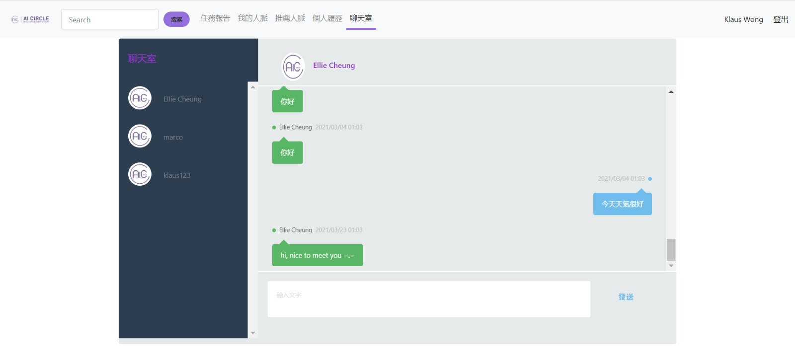
Chatbox

Slide 20
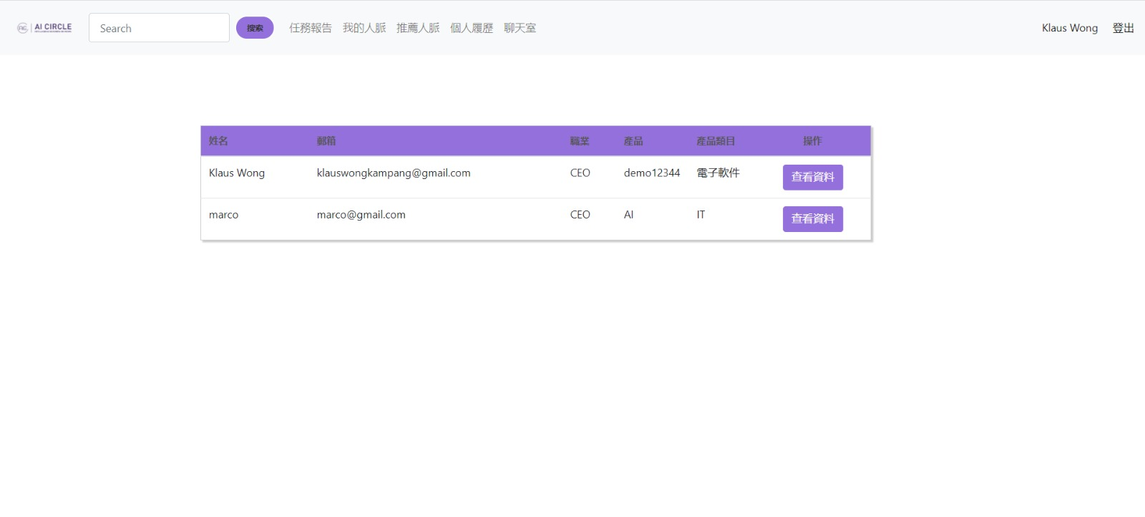
Searching function

Slide 21
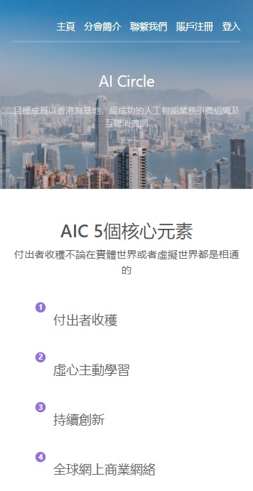
Responsive Landing page

Slide 22
05
Q&A

Slide 23
THANKS
Does anyone have any questions?
marcotam33@gmail.com
+852 68466024

